Slide 1
Hardware Security
Dr. Sana Belguith

Slide 2
Rootkit

Slide 3
Purpose
Give attacker a permanent root access to a system
Hide its presence
Hide from filesystem
Hide its activity
etc…
Steal information
Allow remote code execution

Slide 4
Typical attacker steps
Initial intrusion (e.g. exploit remote execution)
Open remote access (e.g. reverse shell)
Privilege escalation
Download the malicious payload (our rootkit)
Install rootkit
Perform malicious action on command
DDOS
Steal data
etc…

Slide 5
Kernel rootkit

Slide 6
Rootkit high-level understanding
applications
libraries
data
User space
Where what user interact with exists
operating system
Kernel space
Where hardware can be controlled
hardware

Slide 7
Rootkit high-level understanding
applications
libraries
data
User space
operating system
Kernel space
virtual layer
Where virtual machine are managed (optional)
hardware

Slide 8

Rootkit high-level understanding
applications
libraries
data
User space
operating system
Kernel space
Goal hide malicious file/process etc.
rootkit
hardware

Slide 9
Rootkit high-level understanding
applications
libraries
data
User space
ls
operating system
getdents
Kernel space
rootkit
hardware

Slide 10
Rootkit high-level understanding
applications
libraries
data
User space
ls
operating system
Overrides getdents*
Kernel space
rootkit
modify returned value to exclude ../malicious/
hardware
*get directory entries

Slide 11
Rootkit high-level understanding
Modify the behaviour of anything that could reveal malware presence, e.g.:
ls
ps
lsmod
etc…
Give an easy mean to obtain root privileges
applications
libraries
data
User space
operating system
Kernel space
rootkit
hardware

Slide 12
Rootkit high-level understanding
applications
libraries
data
Roughly three techniques
Modify the kernel code;
“Hooking” modify where certain functions point to;
Modify data structure (e.g. active process list)
User space
operating system
Kernel space
rootkit
hardware

Slide 13
Types of rootkit
Application rootkit
Kernel rootkit
Virtualized rootkit
Bootloader rootkit
Hardware & firmware rootkit

Slide 14
Types of rootkit
Application rootkit
Kernel rootkit
Virtualized rootkit
Bootloader rootkit
Hardware & firmware rootkit
They can be prevented/detected by going (at least) one layer down

Slide 15
Trusted Computing Base

Slide 16
Attack Surface
The attack surface is all the possible ways for an attacker to compromise a “system”
Users;
Network;
Operating Systems;
Software;
Hardware;
etc.

Slide 17
Sandboxing
Application

Slide 18
Sandboxing
Application

Slide 19
Sandboxing
Application

Slide 20
Sandboxing
e.g. Browser Sandbox
chrome://sandbox
Application

Slide 21
Trusted Execution Environment
Application

Slide 22
Trusted Execution Environment
e.g. SGX enclave
See next slides
Application

Slide 23
Trusted Computing Base (TCB)
What part of the system do I need to trust in order to achieve my objective
Application

Slide 24

Trusted Computing Base (TCB)
What part of the system do I need to trust in order to achieve my objective
Application

Slide 25
Trusted Computing Base (TCB)
What part of the system do I need to trust in order to achieve my objective
Application
Application
Application
Operating System
Hardware

Slide 26
Trusted Computing Base (TCB)
What part of the system do I need to trust in order to achieve my objective
Application
Hardware

Slide 27
Trusted Platform Module

Slide 28
TPM (Trusted Platform Module)
Trusted Computing Group
Microsoft, Intel, IBM etc…
Promoting standard for more trusted computing
Additional chip on the motherboard
… called TPM
Used for
Disk encryption
System Integrity
Password protection
… and more

Slide 29
Requirements
We can achieve trust if we can verify the system has booted correctly
We assume the PC hardware has not been modified
Key function is in the hardware TPM
We need to monitor the boot process
Initial boot measure by the “Core Root of Trust” (CRTM)
Hash the BIOS, store results in TPM, start the BIOS
BIOS do its job, load the next stage, hash it store in TPM etc…
Core Root of Trust :The first piece of BIOS code that executes on the main processor during the boot process. On a system with a Trusted Platform Module the CRTM is implicitly trusted to bootstrap the process of building a measurement chain for subsequent attestation of other firmware and software that is executed on the computer system.

Slide 30
Authenticated Boot
CRTM - BIOS
TPM

Slide 31
Authenticated Boot
Hash
CRTM - BIOS
BIOS
Report hash
TPM

Slide 32
Authenticated Boot
Hash
CRTM - BIOS
BIOS
Hand-off
Report hash
TPM

Slide 33
Authenticated Boot
Hash
Hash
CRTM - BIOS
BIOS
OS Loader (e.g. GRUB)
Hand-off
Report hash
Report hash
TPM

Slide 34
Authenticated Boot
Hash
Hash
CRTM - BIOS
BIOS
OS Loader (e.g. GRUB)
Hand-off
Hand-off
Report hash
Report hash
TPM

Slide 35
Authenticated Boot
Hash
Hash
Hash
CRTM - BIOS
BIOS
OS Loader (e.g. GRUB)
OS
Hand-off
Hand-off
Report hash
Report hash
TPM
Report hash

Slide 36
TPM registers
Platform configuration registers (PCRs)
Used to store platform integrity metrics
A PCR hold a summary of a series of value
Not the entire chain of hash
The chain can be infinite
A PCR register is extended
PCR = HASH(PCR | new measurement)
Shielded TPM location (i.e. cannot be modified from outside)
Measurement are provided by software

Slide 37
Remote attestation
Attestation is a mechanism for software to prove its identity.
The goal of attestation is to prove to a remote party that your operating system and application software are intact and trustworthy.
The verifier trusts that attestation data is accurate because it is signed by a TPM whose key is certified by the CA.

Slide 38
Basic Remote attestation
1. The application “A” generates a public/private key pair PKA & SKA and asks the TPM to certify it.
2. The TPM computes a hash value #A of the executable code of program “A”.
3. The TPM creates a certification including PKA and #A and signs it with the attestation identity key SKAIK.
4.When application “A” wishes to authenticate itself to a remote party, it sends the cert. of its public key and hash value #A along with a cert. issued to the TPM by a trusted certification authority (CA).
5. The remote party to verifies the cert. chain.
6. The remote party looks #A up in a database which maps hash values to trust levels.
7. If application “A” is deemed trustworthy, we continue the communication, probably by using PKA to establish a session key.

Slide 39
What remote attestation tells you
Positive result
Correct memory content
Good device
Negative result
Malfunctioning device
Malicious device
No response
Malfunctioning device
Malicious device

Slide 40
TPM and Remote Attestation
PCR cannot be modified
Only reset at reboot
TPM contains a key used to sign the attestation
Verifier
Verify the TPM certificate/key
Verify the PCRs
Attestation
PCRs value
sign(PCRs, challenge[nonce])

Slide 41
TPM and Remote Attestation
You do not need to stop at the OS
Can attest kernel modules (e.g. drivers)
Applications?
Configurations?
Scripts?

Slide 42
Intel SGX

Slide 43
Rootkit high-level understanding
applications
libraries
data
User space
operating system
Kernel space
bad code
hardware

Slide 44
Motivation
An attacker can compromise
User space
Operating Systems
Even the hardware!
What can we do?
Execute code in its own secure enclave!

Slide 45
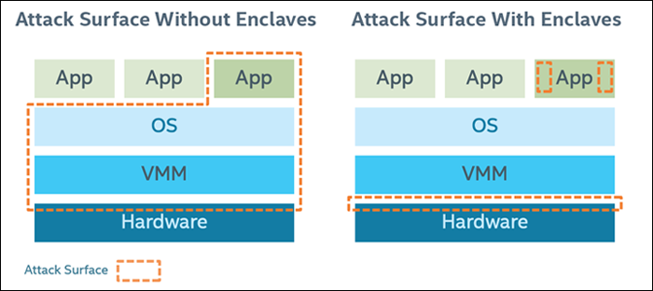
SGX Hardware supported enclave
Idea: run an application within some isolation unit so it cannot be affected by the OS
Do not trust the OS or the VMM/hypervisor
only need to trust the hardware
reduce attack surface

Slide 46
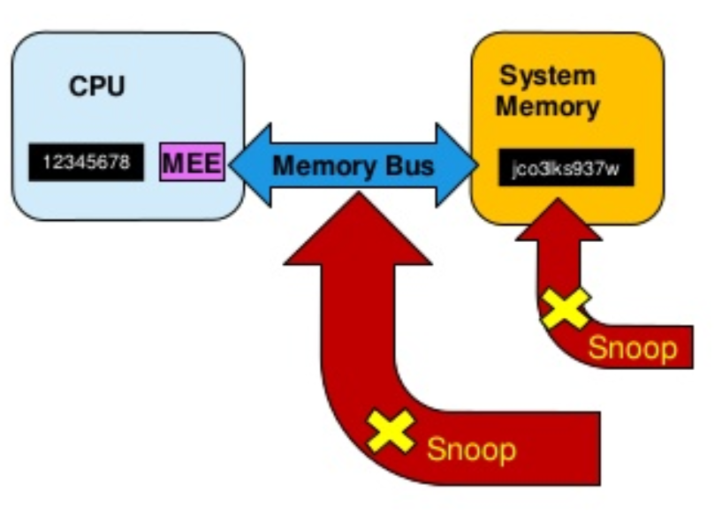
SGX preventing memory snooping attack
* MEE: SGX Memory Encryption Engine
Security boundary is CPU package
Data unencrypted inside the CPU
Data outside the CPU is encrypted
External memory reads and bus snooping only see encrypted data

Slide 47
SGX Programming environment
OS
Enclave Stack
Enclave has its own code and data
Provide confidentiality
Provide integrity
Controlled entry point
Can enter enclave code only at specific point
Enclave execution takes over
Enclave Heap
Enclave
Enclave Code
App Data
App Code
User Process

Slide 48
SGX Application Flow
Call Bridge
Define and divide application into trusted and untrusted part
App create enclave
Trusted function is called
Code in enclave process some secret
Trusted function returns
App continue as normal
2. Create Enclave 3. Trusted() 6. Continue
4. Process Secret 5. Return

Slide 49
ARM Trustzone

Slide 50
ARM Trustzone
Untrusted
Trusted
Application
Application
Application
Trusted Application
Trusted Application

Slide 51
ARM Trustzone
Untrusted
Trusted
Application
Application
Application
Trusted Application
Trusted Application
OS
Secure OS

Slide 52
ARM Trustzone
Untrusted
Trusted
Application
Application
Application
Trusted Application
Trusted Application
Own processor Own RAM address
Own devices
etc…
OS
Secure OS
Secure Monitor

Slide 53
ARM Trustzone
Untrusted
Trusted
Android App
Android App
Android App
Trusted Application
Trusted Application
TrustyLib
TrustyLib
TrustyLib
TrustyLib
TrustyLib
Android OS
Trusty OS
Trusty Driver
Secure Monitor
Trusty Dispatcher

Slide 54
ARM Trustzone
Examples:
Digital Right management
Secure banking
Multi-factor authentication
etc…
Untrusted
Trusted
Android App
Android App
Android App
Trusted Application
Trusted Application
TrustyLib
TrustyLib
TrustyLib
TrustyLib
TrustyLib
Android OS
Trusty OS
Trusty Driver
Secure Monitor
Trusty Dispatcher

